Slide 1
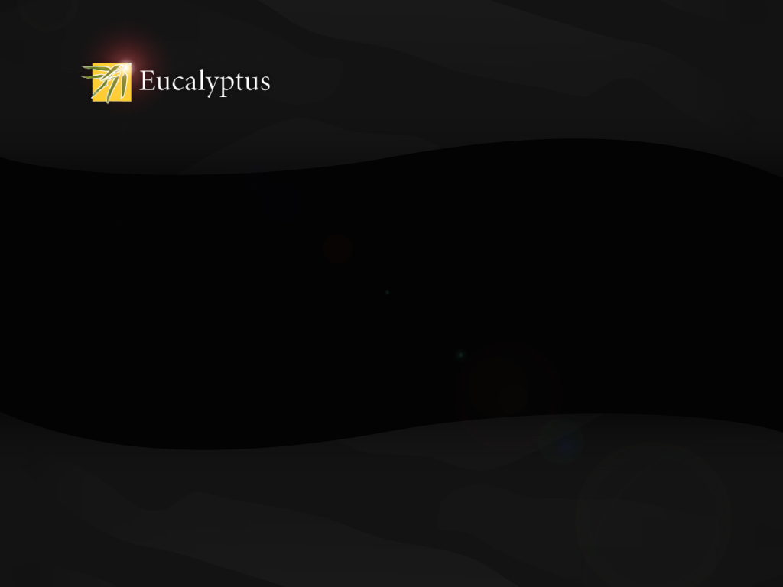
OSCON 2010
Eucalyptus cloud computing platform
Mårten Mickos
CEO
marten@eucalyptus.com
@martenmickos

Slide 2

Shifts in IT Infrastructure
MF
Mini
Client/Server
Cloud
Internet era
Web, Web2.0, Mobile internet
LAMP stack
Eucalyptus Systems, Inc.

Slide 3
Cloud computing & FOSS
Software as a Service
Platform as a Service
Infrastructure as a Service – Public
Infrastructure as a Service – Private (on-premise)
Eucalyptus Systems, Inc.

Slide 4
Eucalyptus
Highly scalable cloud platform for on-premise use
GPL3
12,000+ downloads per month
Also available as a service at open.eucalyptus.com/CommunityCloud
Part of Ubuntu Enterprise Cloud
Revenue generation through Eucalyptus Enterprise Edition
Company founded by 6 PhDs as a spin-off from NSF funded project at UC Santa Barbara
Eucalyptus Systems, Inc.

Slide 5
Thank you!
Mårten Mickos
CEO
marten@eucalyptus.com
@martenmickos

